Slide 1
Predicting eBay Customer Reviews
ADS 509: Team 10
Andrew Zazueta
Kiran Singh
Leonard Littleton

Slide 2
Problem Statement / Introduction
eBay has 1.5 billion active listings
159 million users active
109 million visitors each month
19 million sellers have accounts
Almost 4 out of 10 mobile users have eBay app
$10.2 billion in revenue year 2020

Slide 3
Solution & Implementation
Scrape product reviews from eBay’s API to gather information about products
Use classification models to predict whether reviews are going to be positive or negative
Use topic models to help identify specific words for specific products.

Slide 4
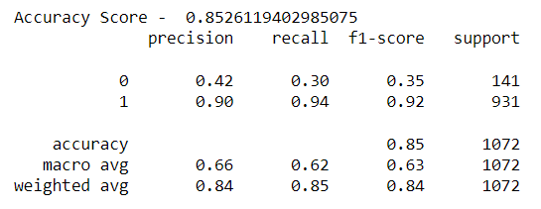
Naïve Bayes Classifier
Probabilistic machine learning model based on Bayes Theorem
Used to classify records using Bernoulli (positive/negative)
Accuracy: 85.26%

Slide 5
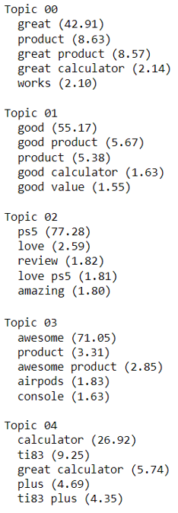
Nonnegative Matrix Factorization
Built using linear algebra
Matrix of interest generated using the product of two positive matrices: Document to Topic and Word to Topic.
3 out of 5 topics identified: PS5, TI-83, AirPods

Slide 6
Recommendations to the Board
eBay contains a huge opportunity due to the volume of sells generated.
Build an API where a customer can input a product URL and find the number of positive reviews in relation to negative to help steer buying decision.
Expanding on this API, top products can be identified and promoted to generate more revenue.

Slide 7
THANK YOU

